Slide 1
CS162 Operating Systems and Systems Programming Lecture 16 General I/O
March 19th, 2018
Profs. Anthony D. Joseph & Jonathan Ragan-Kelley
http://cs162.eecs.Berkeley.edu

Slide 2
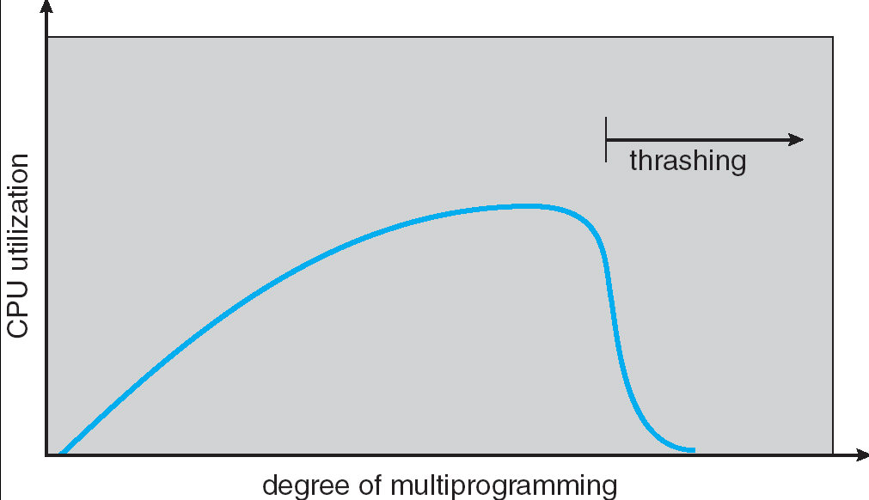
Recall: Thrashing
If a process does not have “enough” pages, the page-fault rate is very high. This leads to:
low CPU utilization
operating system spends most of its time swapping to disk
Thrashing ≡ a process is busy swapping pages in and out
Questions:
How do we detect Thrashing?
What is best response to Thrashing?
Notes:
Example: one program, touches 50 pages (each equally likely). Have only 40 physical page frames.
How bad is this?
- Does your program run at 80% speed?
- Does your program run at 20% speed?
Performance is really bad
If we have enough pages, 200 ns/ref, but if too few pages, assume every 5th page reference causes a page fault
= 4 refs x 200 ns
1 page fault x 10 ms for disk I/O
= 5 refs, 10 ms + 800 ns => 2 ms/ref (not 100 MIPS, but 500 IPS! Factor of 10,000)
Machine appears to have stopped!

Slide 3
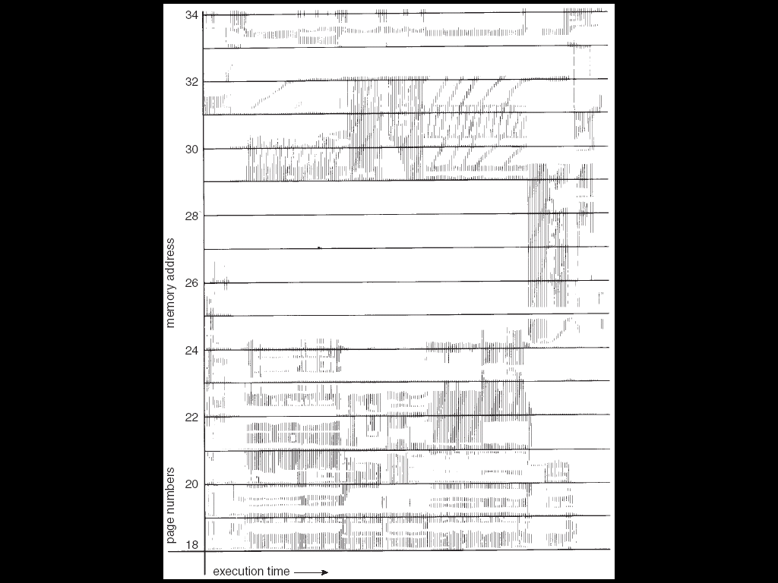
Locality In A Memory-Reference Pattern
Program Memory Access Patterns have temporal and spatial locality
Group of Pages accessed along a given time slice called the “Working Set”
Working Set defines minimum number of pages needed for process to behave well
Not enough memory for Working Set ⇒ Thrashing
Better to swap out process?

Slide 4
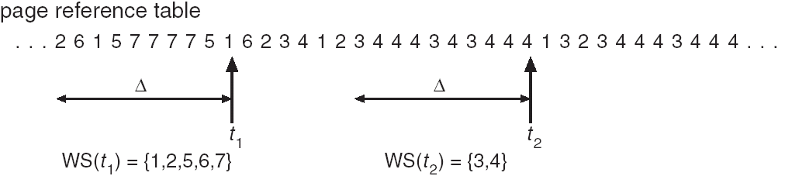
Working-Set Model
Δ ≡ working-set window ≡ fixed number of page references
Example: 10,000 instructions
WS_{i} (working set of Process P_{i}) = total set of pages referenced in the most recent Δ (varies in time)
if Δ too small will not encompass entire locality
if Δ too large will encompass several localities
if Δ = ∞ ⇒ will encompass entire program
D = Σ|WS_{i}| ≡ total demand frames
if D > m ⇒ Thrashing
Policy: if D > m, then suspend/swap out processes
This can improve overall system behavior by a lot!

Slide 5
What about Compulsory Misses?
Recall that compulsory misses are misses that occur the first time that a page is seen
Pages that are touched for the first time
Pages that are touched after process is swapped out/swapped back in
Clustering:
On a page-fault, bring in multiple pages “around” the faulting page
Since efficiency of disk reads increases with sequential reads, makes sense to read several sequential pages
Working Set Tracking:
Use algorithm to try to track working set of application
When swapping process back in, swap in working set

Slide 6
Reverse Page Mapping (Sometimes called “Coremap”)
Physical page frames often shared by many different address spaces/page tables
All children forked from given process
Shared memory pages between processes
Whatever reverse mapping mechanism that is in place must be very fast
Must hunt down all page tables pointing at given page frame when freeing a page
Must hunt down all PTEs when seeing if pages “active”
Implementation options:
For every page descriptor, keep linked list of page table entries that point to it
Management nightmare – expensive
Linux 2.6: Object-based reverse mapping
Link together memory region descriptors instead (much coarser granularity)

Slide 7
Linux Memory Details?
Memory management in Linux considerably more complex that the previous indications
Memory Zones: physical memory categories
ZONE_DMA: < 16MB memory, DMAable on ISA bus
ZONE_NORMAL: 16MB → 896MB (mapped at 0xC0000000)
ZONE_HIGHMEM: Everything else (> 896MB)
Each zone has 1 freelist, 2 LRU lists (Active/Inactive)
Many different types of allocation
SLAB allocators, per-page allocators, mapped/unmapped
Many different types of allocated memory:
Anonymous memory (not backed by a file, heap/stack)
Mapped memory (backed by a file)
Allocation priorities
Is blocking allowed/etc

Slide 8
Recall: Linux Virtual memory map
0xFFFFFFFF
0xFFFFFFFFFFFFFFFF
Kernel Addresses
1GB
Kernel Addresses
128TiB
896MB Physical
64 TiB Physical
0xC0000000
User Addresses
0xFFFF800000000000
3GB Total
Empty
Space
“Canonical Hole”
0x00007FFFFFFFFFFF
128TiB
User
Addresses
0x00000000
0x0000000000000000
32-Bit Virtual Address Space
64-Bit Virtual Address Space

Slide 9
The Requirements of I/O
So far in this course:
We have learned how to manage CPU and memory
What about I/O?
Without I/O, computers are useless (disembodied brains?)
But… thousands of devices, each slightly different
How can we standardize the interfaces to these devices?
Devices unreliable: media failures and transmission errors
How can we make them reliable???
Devices unpredictable and/or slow
How can we manage them if we don’t know what they will do or how they will perform?

Slide 10
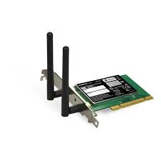
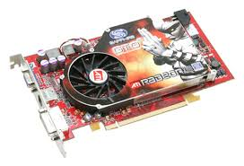


OS Basics: I/O
Threads
Address Spaces
Windows
Processes
Files
Sockets
Software
OS Hardware Virtualization
Hardware
ISA
Memory
Processor
Protection Boundary
OS
Ctrlr
storage
Networks
Displays
Inputs

Slide 11
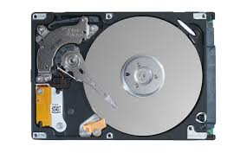
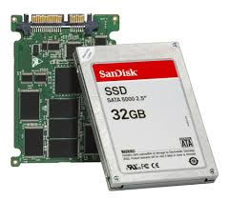
In a Picture
Read / Write
wires
Processor
I/O
Controllers
Secondary Storage (Disk)
Core
L2 Cache
Registers
L1 Cache
interrupts
Secondary Storage (SSD)
Main
Memory
(DRAM)
Read / Write
DMA transfer
L3 Cache (shared)
Core
L2 Cache
Registers
L1 Cache
I/O devices you recognize are supported by I/O Controllers
Processors accesses them by reading and writing IO registers as if they were memory
Write commands and arguments, read status and results

Slide 12
Operational Parameters for I/O
Data granularity: Byte vs. Block
Some devices provide single byte at a time (e.g., keyboard)
Others provide whole blocks (e.g., disks, networks, etc.)
Access pattern: Sequential vs. Random
Some devices must be accessed sequentially (e.g., tape)
Others can be accessed “randomly” (e.g., disk, cd, etc.)
Fixed overhead to start transfers
Some devices require continual monitoring
Others generate interrupts when they need service
Transfer Mechanism: Programmed IO and DMA

Slide 13

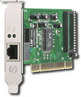
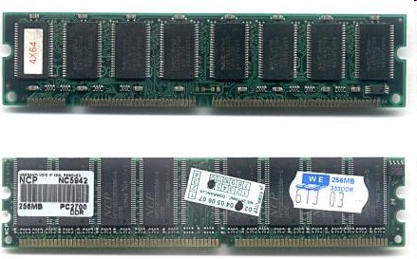
Kernel Device Structure
The System Call Interface
Process
Management
Memory Management
Filesystems
Device Control
Networking
Concurrency, multitasking
Virtual memory
Files and dirs: the VFS
TTYs and device access
Connectivity
Architecture
Dependent
Code
Memory Manager
File System Types
Device Control
Network Subsystem
Block Devices
IF drivers

Slide 14
The Goal of the I/O Subsystem
Provide Uniform Interfaces, Despite Wide Range of Different Devices
This code works on many different devices:
FILE fd = fopen("/dev/something", "rw"); for (int i = 0; i < 10; i++) { fprintf(fd, "Count %d\n", i); } close(fd);
Why? Because code that controls devices (“device driver”) implements standard interface
We will try to get a flavor for what is involved in actually controlling devices in rest of lecture
Can only scratch surface!

Slide 15
Want Standard Interfaces to Devices
Block Devices: e.g. disk drives, tape drives, DVD-ROM
Access blocks of data
Commands include open(), read(), write(), seek()
Raw I/O or file-system access
Memory-mapped file access possible
Character Devices: e.g. keyboards, mice, serial ports, some USB devices
Single characters at a time
Commands include get(), put()
Libraries layered on top allow line editing
Network Devices: e.g. Ethernet, Wireless, Bluetooth
Different enough from block/character to have own interface
Unix and Windows include socket interface
Separates network protocol from network operation
Includes select() functionality
Usage: pipes, FIFOs, streams, queues, mailboxes

Slide 16
How Does User Deal with Timing?
Blocking Interface: “Wait”
When request data (e.g. read() system call), put process to sleep until data is ready
When write data (e.g. write() system call), put process to sleep until device is ready for data
Non-blocking Interface: “Don’t Wait”
Returns quickly from read or write request with count of bytes successfully transferred
Read may return nothing, write may write nothing
Asynchronous Interface: “Tell Me Later”
When request data, take pointer to user’s buffer, return immediately; later kernel fills buffer and notifies user
When send data, take pointer to user’s buffer, return immediately; later kernel takes data and notifies user

Slide 17
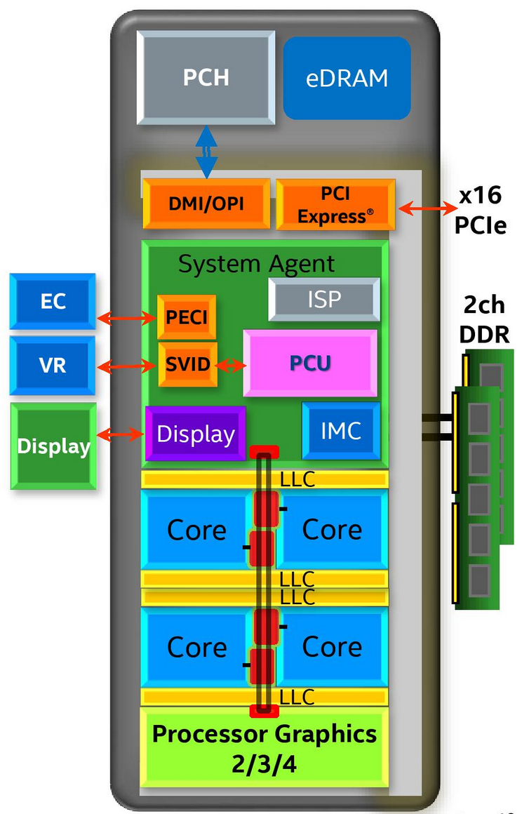
Chip-scale Features of 2015 x86 (Sky Lake)
Significant pieces:
Four OOO cores with deeper buffers
New Intel MPX (Memory Protection Extensions)
New Intel SGX (Software Guard Extensions)
Issue up to 6 μ-ops/cycle
Integrated GPU, System Agent (Mem, Fast I/O)
Large shared L3 cache with on-chip ring bus
2 MB/core instead of 1.5 MB/core
High-BW access to L3 Cache
Integrated I/O
Integrated memory controller (IMC)
Two independent channels of DDR3L/DDR4 DRAM
High-speed PCI-Express (for Graphics cards)
Direct Media Interface (DMI) Connection to PCH (Platform Control Hub)
Notes:
Let’s look at I/O in a modern processor.

Slide 18
Sky Lake I/O: PCH
Platform Controller Hub
Connected to processor with proprietary bus
Direct Media Interface
Types of I/O on PCH:
USB, Ethernet
Thunderbolt 3
Audio, BIOS support
More PCI Express (lower speed than on Processor)
SATA (for Disks)
Sky Lake
System Configuration

Slide 19
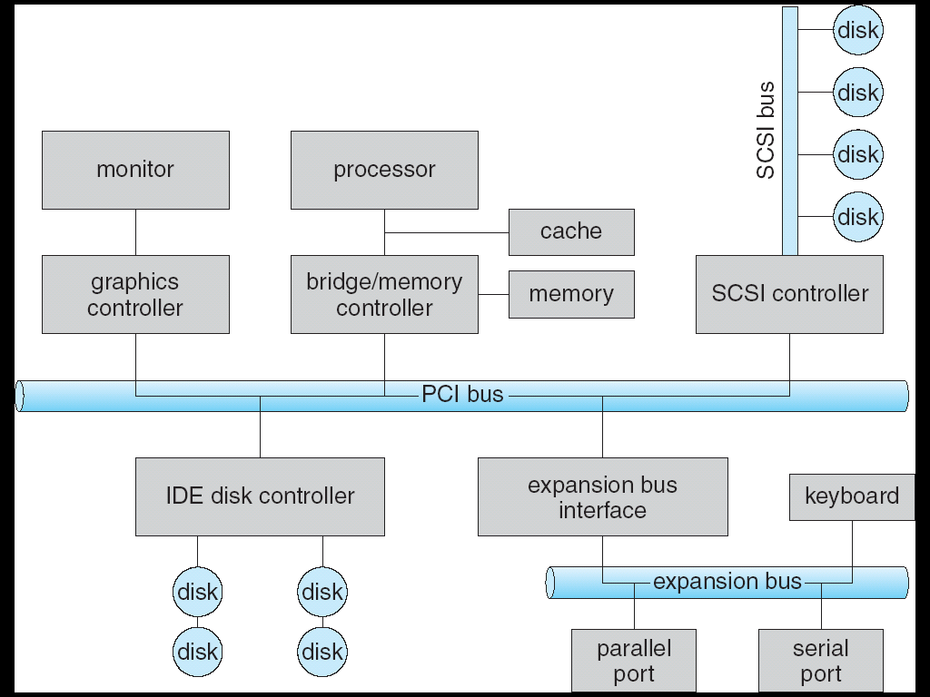

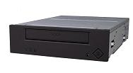
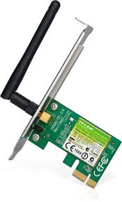
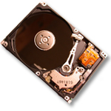

Modern I/O Systems
network

Slide 20
Example: PCI Architecture
RAM
Memory
Bus
CPU
Host Bridge
PCI #0
ISA Bridge
PCI Bridge
PCI #1
ISA Controller
PCI Slots
USB Controller
SATA Controller
Scanner
Legacy Devices
Root Hub
Hard Disk
DVD ROM
Hub
Webcam
Mouse
Keyboard

Slide 21
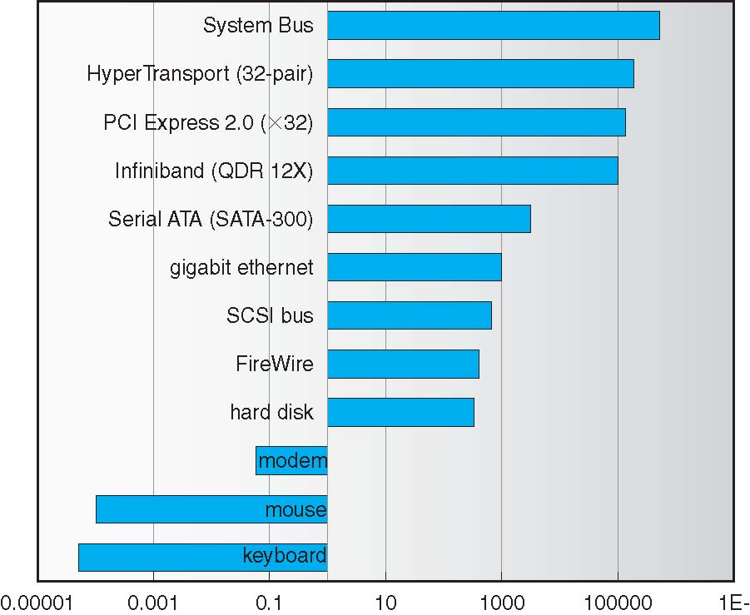
Example Device-Transfer Rates in Mb/s (Sun Enterprise 6000)
10m
Device Rates vary over 12 orders of magnitude !!!
System better be able to handle this wide range
Better not have high overhead/byte for fast devices!
Better not waste time waiting for slow devices

Slide 22
How does the processor actually talk to the device?
Processor Memory Bus
Regular
Memory
CPU
Bus
Adaptor
Bus
Adaptor
Device
Controller
Address +
Data
Other Devices
or Buses
Bus
Interface
Hardware
Controller
Interrupt
Controller
Interrupt Request
read
Addressable
Memory
and/or
Queues
write
CPU interacts with a Controller
Contains a set of registers that can be read and written
May contain memory for request queues or bit-mapped images
Regardless of the complexity of the connections and buses, processor accesses registers in two ways:
I/O instructions: in/out instructions
Example from the Intel architecture: out 0x21,AL
Memory mapped I/O: load/store instructions
Registers/memory appear in physical address space
I/O accomplished with load and store instructions
control
status
Registers
(port 0x20)
Memory Mapped
Region: 0x8f008020

Slide 23
Example: Memory-Mapped Display Controller
Memory-Mapped:
Hardware maps control registers and display memory into physical address space
Addresses set by HW jumpers or at boot time
Simply writing to display memory (also called the “frame buffer”) changes image on screen
Addr: 0x8000F000 — 0x8000FFFF
Writing graphics description to cmd queue
Say enter a set of triangles describing some scene
Addr: 0x80010000 — 0x8001FFFF
Writing to the command register may cause on-board graphics hardware to do something
Say render the above scene
Addr: 0x0007F004
Can protect with address translation
0x80020000
Graphics
Command
Queue
0x80010000
Display
Memory
0x8000F000
0x0007F004
Command
0x0007F000
Status
Physical
Address
Space

Slide 24
Administrivia
THURSDAY
Midterm 2 coming up on 3/22 8-10:00PM
All topics up to and including Lecture 16
Focus will be on Lectures 10 – 16 and associated readings
Projects 1 and 2
Homework 0 – 2
Closed book
1 page hand-written notes both sides
Room assignments posted on Piazza
20 / 126 / 170 Barrows, 155 Kroeber, 101 Moffitt, 105 North Gate

Slide 25
break

Slide 26
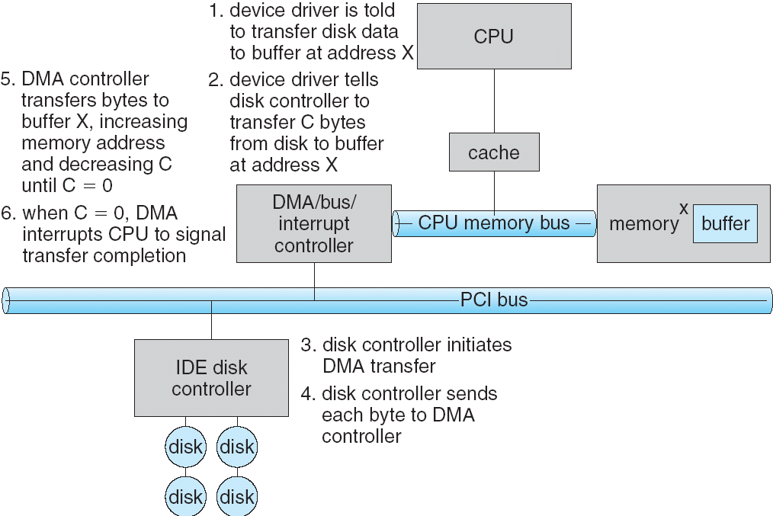
Transferring Data To/From Controller
Programmed I/O:
Each byte transferred via processor in/out or load/store
Pro: Simple hardware, easy to program
Con: Consumes processor cycles proportional to data size
Direct Memory Access:
Give controller access to memory bus
Ask it to transfer data blocks to/from memory directly
Sample interaction with DMA controller (from OSC book):
1
2
3

Slide 27
Transferring Data To/From Controller
Programmed I/O:
Each byte transferred via processor in/out or load/store
Pro: Simple hardware, easy to program
Con: Consumes processor cycles proportional to data size
Direct Memory Access:
Give controller access to memory bus
Ask it to transfer data blocks to/from memory directly
Sample interaction with DMA controller (from OSC book):
6
5
4

Slide 28
I/O Device Notifying the OS
The OS needs to know when:
The I/O device has completed an operation
The I/O operation has encountered an error
I/O Interrupt:
Device generates an interrupt whenever it needs service
Pro: handles unpredictable events well
Con: interrupts relatively high overhead
Polling:
OS periodically checks a device-specific status register
I/O device puts completion information in status register
Pro: low overhead
Con: may waste many cycles on polling if infrequent or unpredictable I/O operations
Actual devices combine both polling and interrupts
For instance – High-bandwidth network adapter:
Interrupt for first incoming packet
Poll for following packets until hardware queues are empty
Notes:
After the OS has issued a command to the I/O device either via a special I/O instruction or by writing to a location in the I/O address space, the OS needs to be notified when:
(a) The I/O device has completed the operation.
(b) Or when the I/O device has encountered an error.
This can be accomplished in two different ways: Polling and I/O interrupt.
+1 = 58 min. (Y:38)

Slide 29
Device Drivers
Device Driver: Device-specific code in the kernel that interacts directly with the device hardware
Supports a standard, internal interface
Same kernel I/O system can interact easily with different device drivers
Special device-specific configuration supported with the ioctl() system call
Device Drivers typically divided into two pieces:
Top half: accessed in call path from system calls
implements a set of standard, cross-device calls like open(), close(), read(), write(), ioctl(), strategy()
This is the kernel’s interface to the device driver
Top half will start I/O to device, may put thread to sleep until finished
Bottom half: run as interrupt routine
Gets input or transfers next block of output
May wake sleeping threads if I/O now complete

Slide 30
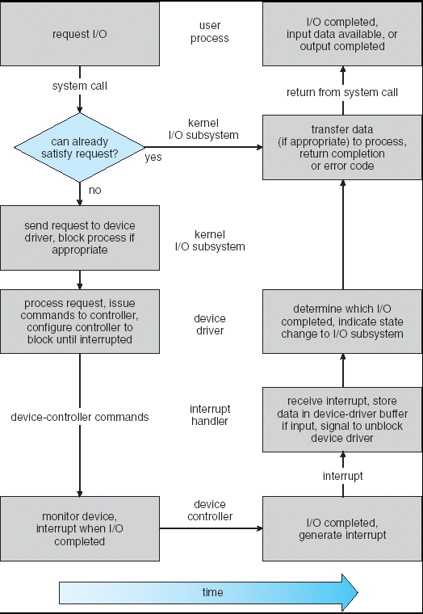
Life Cycle of An I/O Request
User
Program
Kernel I/O
Subsystem
Device Driver
Top Half
Device Driver
Bottom Half
Device
Hardware

Slide 31
Basic Performance Concepts
Response Time or Latency: Time to perform an operation(s)
Bandwidth or Throughput: Rate at which operations are performed (op/s)
Files: MB/s, Networks: Mb/s, Arithmetic: GFLOP/s
Start up or “Overhead”: time to initiate an operation
Most I/O operations are roughly linear in n bytes
Latency(n) = Overhead + n/TransferCapacity

Slide 32
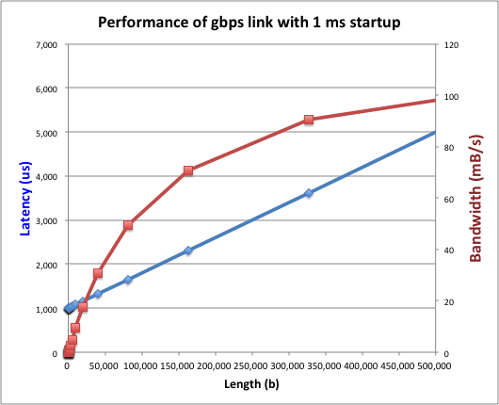
Example (Fast Network)
Consider a 1 Gb/s link (B = 125 MB/s)
With a startup cost S = 1 ms
Latency(n) = S + n/B
Bandwidth = n/(S + n/B) = B*n/(B*S + n) = B/(B*S/n + 1)

Slide 33
Example (Fast Network)
Consider a 1 Gb/s link (B = 125 MB/s)
With a startup cost S = 1 ms
Bandwidth = B/(B*S/n + 1)
half-power point occurs at n=S*B → Bandwidth = B/2

Slide 34
Example: at 10 ms startup (like Disk)
n = 1,250,000 bytes!

Slide 35
What Determines Peak BW for I/O ?
Bus Speed
PCI-X: 1064 MB/s = 133 MHz x 64 bit (per lane)
ULTRA WIDE SCSI: 40 MB/s
Serial Attached SCSI & Serial ATA & IEEE 1394 (firewire): 1.6 Gb/s full duplex (200 MB/s)
USB 3.0 – 5 Gb/s
Thunderbolt 3 – 40 Gb/s
Device Transfer Bandwidth
Rotational speed of disk
Write / Read rate of NAND flash
Signaling rate of network link
Whatever is the bottleneck in the path…

Slide 36
Storage Devices
Magnetic disks
Storage that rarely becomes corrupted
Large capacity at low cost
Block level random access (except for SMR – later!)
Slow performance for random access
Better performance for sequential access
Flash memory
Storage that rarely becomes corrupted
Capacity at intermediate cost (5-20x disk)
Block level random access
Good performance for reads; worse for random writes
Erasure requirement in large blocks
Wear patterns issue

Slide 37
The Amazing Magnetic Disk
Unit of Transfer: Sector
Ring of sectors form a track
Stack of tracks form a cylinder
Heads position on cylinders
Disk Tracks ~ 1µm (micron) wide
Wavelength of light is ~ 0.5µm
Resolution of human eye: 50µm
100K tracks on a typical 2.5” disk
Separated by unused guard regions
Reduces likelihood neighboring tracks are corrupted during writes (still a small non-zero chance)

Slide 38
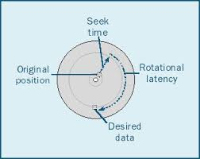
Review: Magnetic Disks
Track
Cylinders: all the tracks under the head at a given point on all surface
Read/write data is a three-stage process:
Seek time: position the head/arm over the proper track
Rotational latency: wait for desired sector to rotate under r/w head
Transfer time: transfer a block of bits (sector) under r/w head
Sector
Head
Cylinder
Platter
Seek time = 4-8ms
One rotation = 1-2ms (3600-7200 RPM)

Slide 39
Review: Magnetic Disks
Track
Cylinders: all the tracks under the head at a given point on all surface
Read/write data is a three-stage process:
Seek time: position the head/arm over the proper track
Rotational latency: wait for desired sector to rotate under r/w head
Transfer time: transfer a block of bits (sector) under r/w head
Sector
Head
Cylinder
Platter
Disk Latency = Queueing Time + Controller time +
Seek Time + Rotation Time + Xfer Time
Software
Queue
(Device Driver)
Hardware
Controller
Media Time
(Seek+Rot+Xfer)
Request
Result

Slide 40
Disk Performance Example
Assumptions:
Ignoring queuing and controller times for now
Avg seek time of 5ms,
7200RPM ⇒ Time for rotation: 60000 (ms/minute) / 7200(rev/min) ~= 8ms
Transfer rate of 4MByte/s, sector size of 1 Kbyte ⇒ 1024 bytes/4×10⁶ (bytes/s) = 256 × 10⁻⁶ sec ≅ .26 ms
Read sector from random place on disk:
Seek (5ms) + Rot. Delay (4ms) + Transfer (0.26ms)
Approx 10ms to fetch/put data: 100 KByte/sec
Read sector from random place in same cylinder:
Rot. Delay (4ms) + Transfer (0.26ms)
Approx 5ms to fetch/put data: 200 KByte/sec
Read next sector on same track:
Transfer (0.26ms): 4 MByte/sec
Key to using disk effectively (especially for file systems) is to minimize seek and rotational delays

Slide 41
Typical Numbers for Magnetic Disk
Parameter | Info / Range
Space/Density | Space: 8TB (Seagate), 10TB (Hitachi) in 3½ inch form factor! Areal Density: ≥ 1Terabit/square inch! (SMR, Helium, …)
Average seek time | Typically 5-10 milliseconds. Depending on reference locality, actual cost may be 25-33% of this number.
Average rotational latency | Most laptop/desktop disks rotate at 3600-7200 RPM (16-8 ms/rotation). Server disks up to 15,000 RPM. Average latency is halfway around disk so 8-4 milliseconds
Controller time | Depends on controller hardware
Transfer time | Typically 50 to 100 MB/s. Depends on: Transfer size (usually a sector): 512B – 1KB per sector Rotation speed: 3600 RPM to 15000 RPM Recording density: bits per inch on a track Diameter: ranges from 1 in to 5.25 in
Cost | Used to drop by a factor of two every 1.5 years (or even faster); now slowing down
Notes:
As far as rotational latency is concerned, most disks rotate at 3,600 RPM or approximately 16 ms per revolution.
Since on average, the information you desired is half way around the disk, the average rotational latency will be 8ms.
The transfer time is a function of transfer size, rotation speed, and recording density.
The typical transfer speed is 2 to 4 MB per second.
Notice that the transfer time is much faster than the rotational latency and seek time.
This is similar to the DRAM situation where the DRAM access time is much shorter than the DRAM cycle time.
***** Do anybody remember what we did to take advantage of the short access time versus cycle time? Well, we interleave!
New International Disk Drive, Equipment, and Materials Association standard is 4KB sectors instead of 512 byte sectors
+2 = 36 min. (Y:16)

Slide 42
(Lots of) Intelligence in the Controller
Sectors contain sophisticated error correcting codes
Disk head magnet has a field wider than track
Hide corruptions due to neighboring track writes
Sector sparing
Remap bad sectors transparently to spare sectors on the same surface
Slip sparing
Remap all sectors (when there is a bad sector) to preserve sequential behavior
Track skewing
Sector numbers offset from one track to the next, to allow for disk head movement for sequential ops
…

Slide 43

Seagate Enterprise
10 TB (2016)
7 platters, 14 heads
7200 RPMs
6 Gbps SATA /12Gbps SAS interface
220MB/s transfer rate, cache size: 256MB
Helium filled: reduce friction and power usage
Price: $500 ($0.05/GB)
IBM Personal Computer/AT (1986)
30 MB hard disk
30-40ms seek time
0.7-1 MB/s (est.)
Price: $500 ($17K/GB, 340,000x more expensive !!)

Slide 44
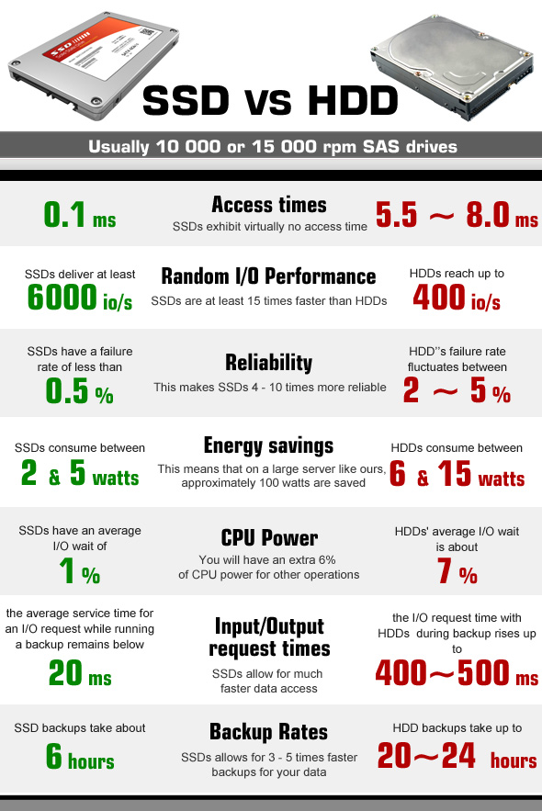
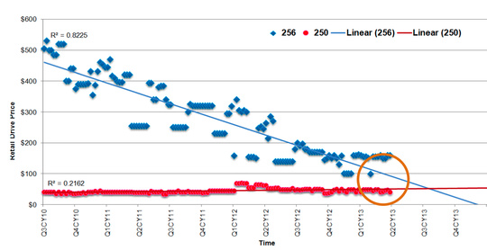
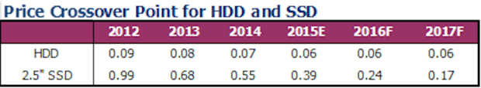
HDD vs SSD Comparison
SSD prices drop much faster than HDD

Slide 45
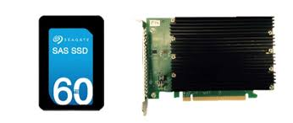
Largest SSDs
60TB (2016)
Dual port: 16Gbs
Seq reads: 1.5GB/s
Seq writes: 1GB/s
Random Read Ops (IOPS): 150K
Price: ~ $20K ($0.33/GB)

Slide 46
Summary
I/O Devices Types:
Many different speeds (0.1 bytes/sec to GBytes/sec)
Different Access Patterns:
Block Devices, Character Devices, Network Devices
Different Access Timing:
Blocking, Non-blocking, Asynchronous
I/O Controllers: Hardware that controls actual device
Processor Accesses through I/O instructions, load/store to special physical memory
Notification mechanisms
Interrupts
Polling: Report results through status register that processor looks at periodically
Device drivers interface to I/O devices
Provide clean Read/Write interface to OS above
Manipulate devices through PIO, DMA & interrupt handling
Three types: block, character, and network

